Slide 1
Introduction to Image analysis
1. Introduction & Basic concepts
Robert Haase, HongKee Moon, Benoit Lombardot
MPI-CBG, Scientific Computing Facility
October 23rd – 25th 2017
Section goals :
Introduction to the course, image analysis and Fiji
Image characteristics and visualization
Regions of interest and measures

Slide 2

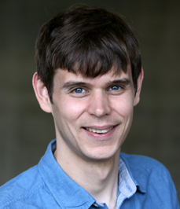
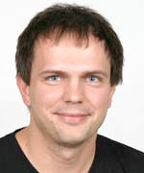
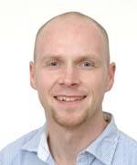
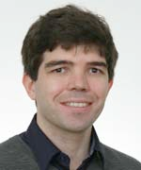
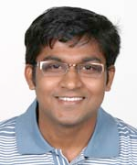
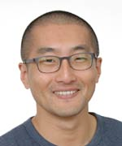
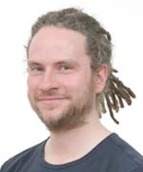
Image Analysis, Intro & basic concepts
Scientific Computing Facility (SCF)
“The Scientific Computing Facility aims to provide a unified service to assist researchers in the tackling of scientific questions involving computational analysis, large data handling and image processing.”
Ian Henry: Facility Leader
BSc: Molecular Biology (Edinburgh)
PhD: Genetics/Bioinformatics (Nottingham)
Bioinformatics
Holger Brandl:
Senior Data Engineer
Diploma: Biomathematics (Greifswald)
PhD: Computer Science (Bielefeld)
Naha Lakshmanaperumal
Bioinformatician
BSc: Biotechnology (Tamil Nadu)
MSc: Bioinformatics (Saarland)
Scientific Software
Development
Peter Steinbach
HPC Developer
Diploma: Physics (Leipzig)
PhD: Particle Physics (Dresden)
HongKee Moon
Software Developer
B.Eng: Computer Science (Seoul)
M.Eng: Computer Science (Seoul)
Image Processing
Benoit Lombardot
Senior Image Analyst
MSc: Cognitive Science (Paris)
PhD: Bioimage analysis (Paris)
Robert Haase
Image Analyst
Diploma: Computer Science (Dresden)
PhD: Medical Radiation Sciences (TUD)
Notes:
Bio Image informatics service is embedded in the SCF:
Together with bioInformatics and Scientific software development

Slide 3
Overview
Image Analysis, Intro & basic concepts
Day 1:
Introduction & basic concepts
Segmentation 1
Day 2:
Measure in time sequence and tracking
Segmentation 2
Day 3:
Visualize and Explore 3D images
Spot detection and segmentation in 3D
Notes:
Blocks a 6/7 slides presenting concepts and tools followed by guided exercises
Blocks start with basic ideas and gradually introduce more complex things
For the exercise we try to have a template that you can follow
The course is an introduction assuming you never have open Fiji (ask a few question to get the room level)
We’ll walk in the room to help
Use Stickers (Green=done!, Red=Help me! ) it will help us adjust timing
For part 5 and 6 At the end the course you’ll exercise/demo you like
1 or 2 depending on time

Slide 4
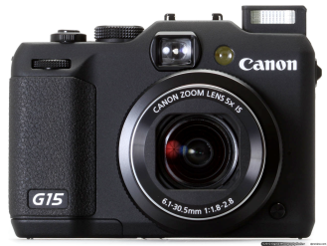
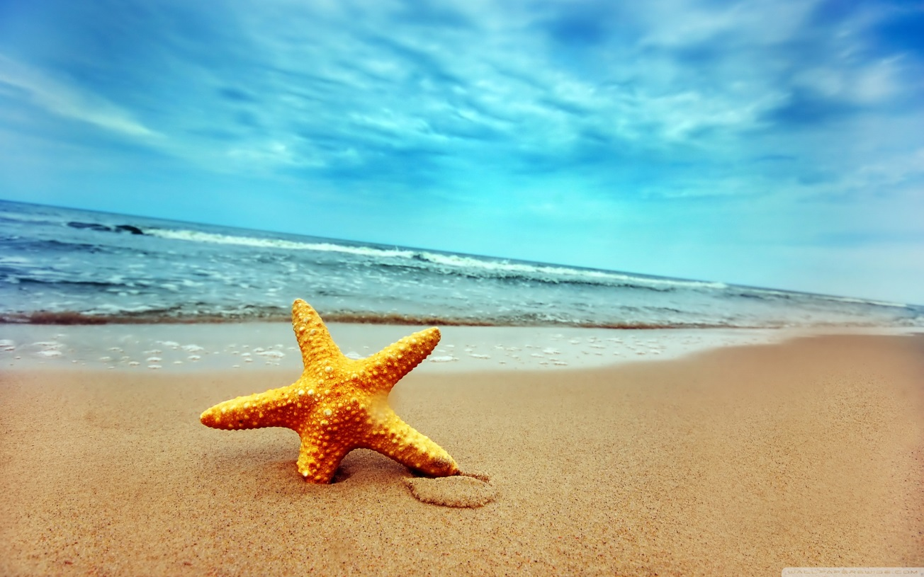
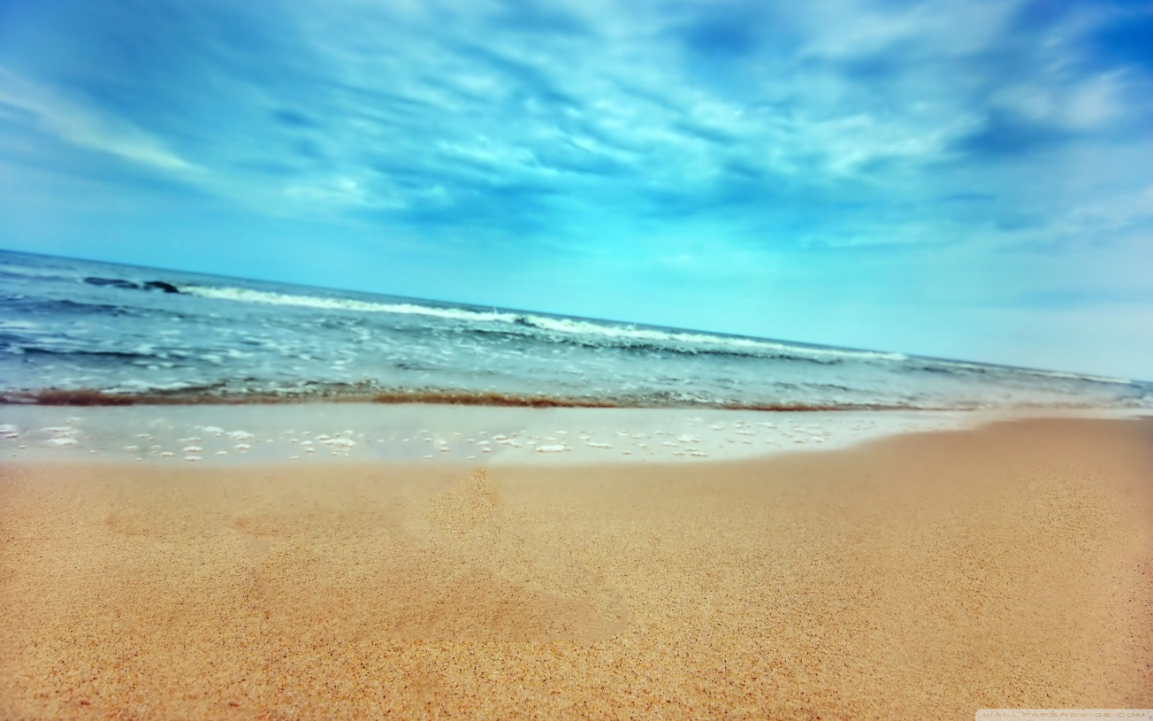
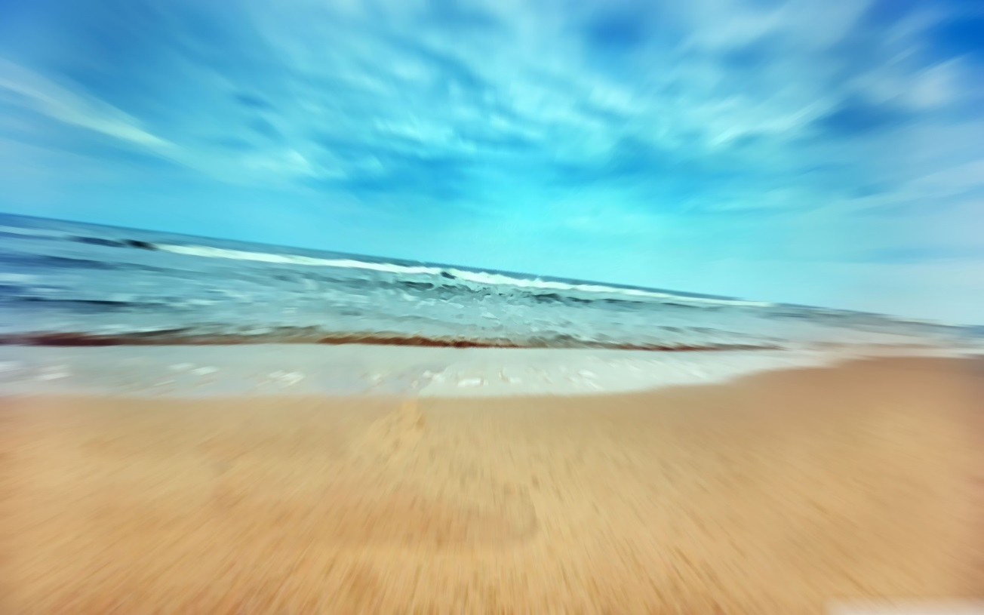


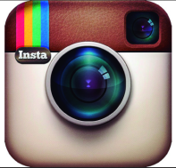
Image Analysis, Intro & basic concepts
Image analysis (1/2)
This is not
Image Analysis

Slide 5
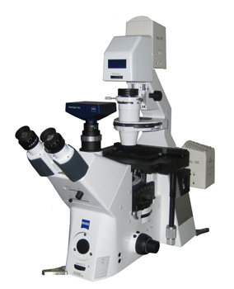
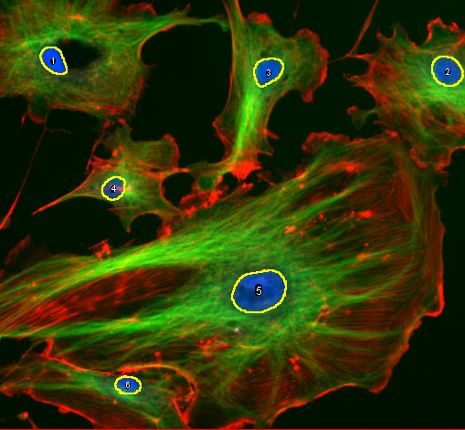
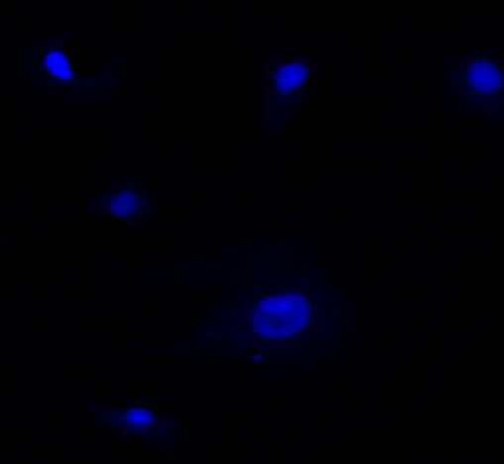
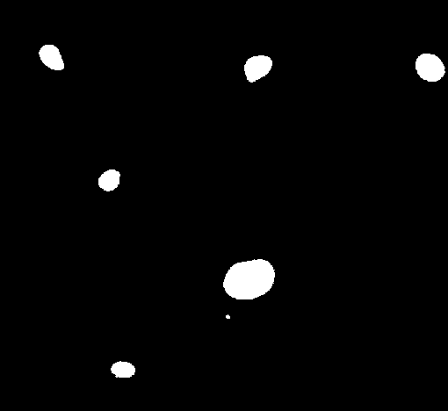
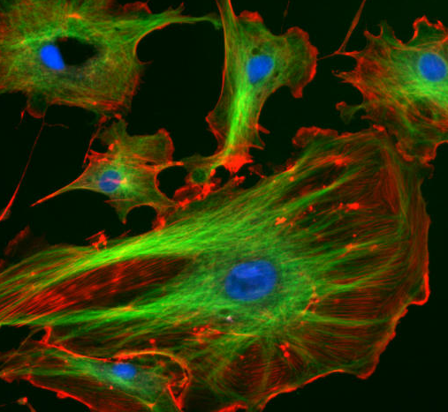



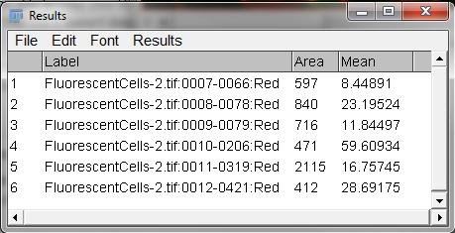



Image Analysis, Intro & basic concepts
Image analysis (2/2)
Notes:
There a few people on the campus working on Image analysis service (IAS). I worked in an IAS
With that presentation we would like to give you a flavour of what IA can do for you and how we can help
Probably all familiar with photoediting software. Make a picture cuter! A subjective process
Doing IA for science is different needs objectivity which imply quantification, repeatability
I you have image and good question, there are a lot of soft that can help you.
And if you go in this rigorous way and work maybe in a few years you can win a medal
Transition: However in practice IA is not just one more step in your research pipeline

Slide 6


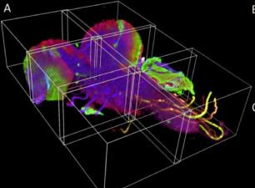
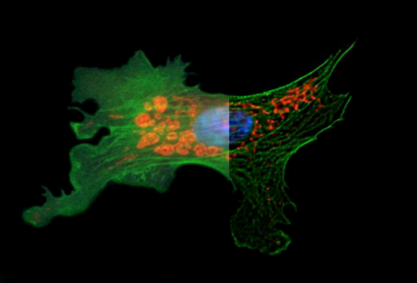
Image Analysis, Intro & basic concepts Bio Image Analysis
Image preparation:
Deconvolution
Image fusion
Sequence alignement
Bleaching correction
Bleed through correction
…

Slide 7
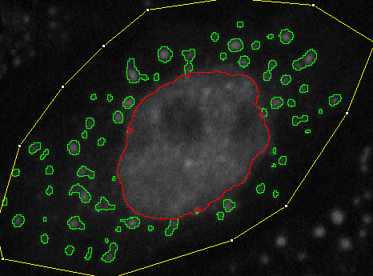
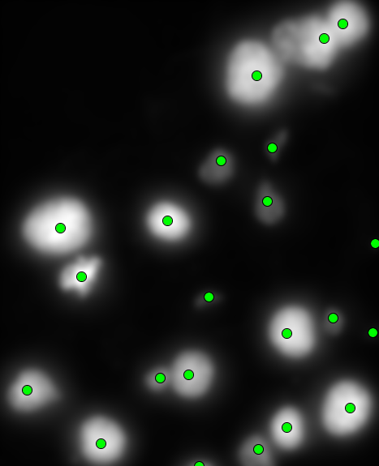
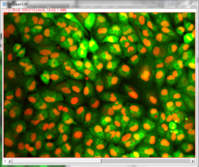
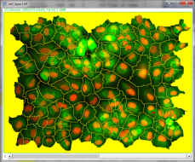
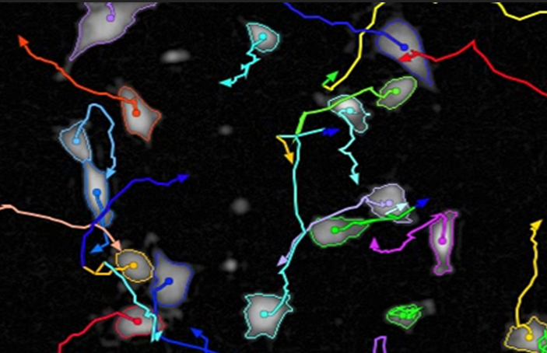
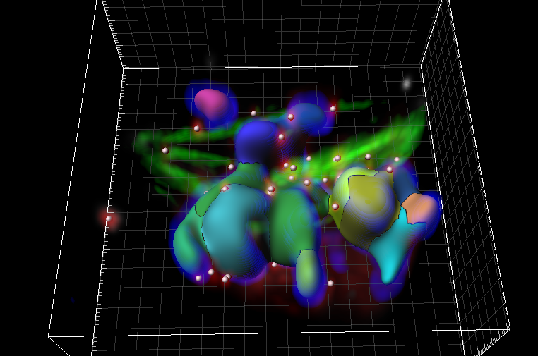
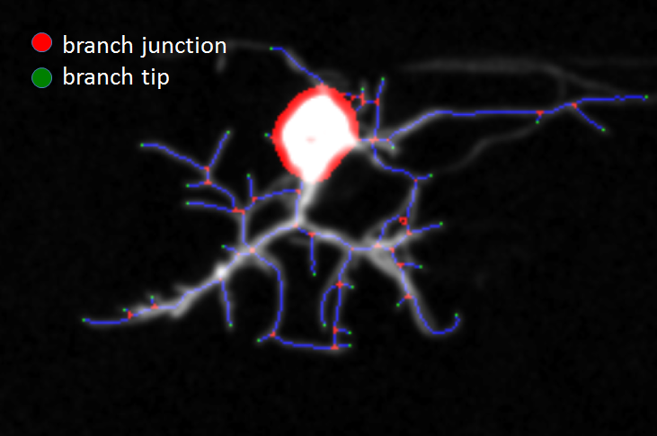
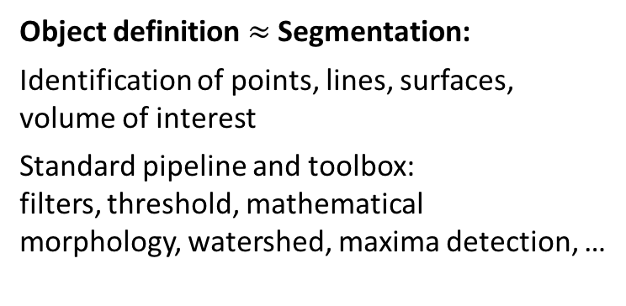
Image Analysis, Intro & basic concepts Bio Image Analysis
Image preparation
Object definition $≈$ Segmentation:
Identification of points, lines, surfaces, volume of interest
Standard pipeline and toolbox: filters, threshold, mathematical morphology, watershed, maxima detection, …

Slide 8
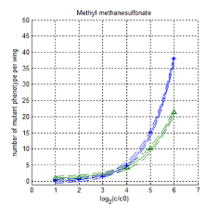
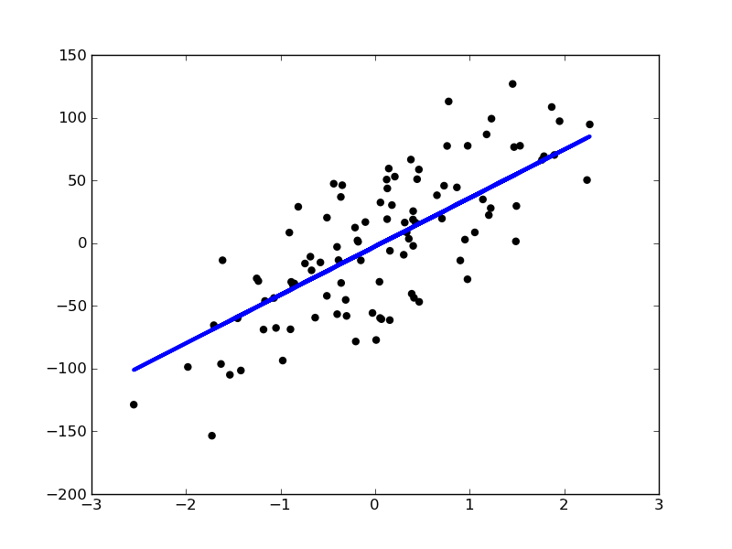
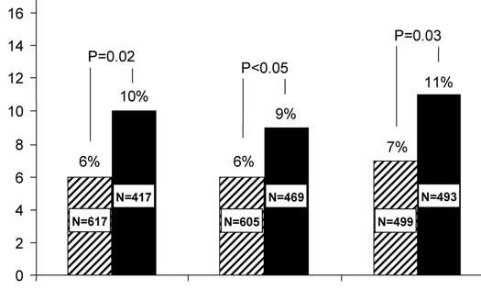
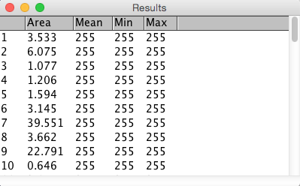

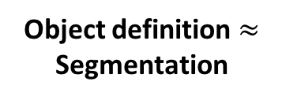
Image Analysis, Intro & basic concepts Bio Image Analysis
Image preparation
Object definition $≈$ Segmentation
Characterization:
Objects characteristics measures
Inter object relation
Modelling
Significance test

Slide 9
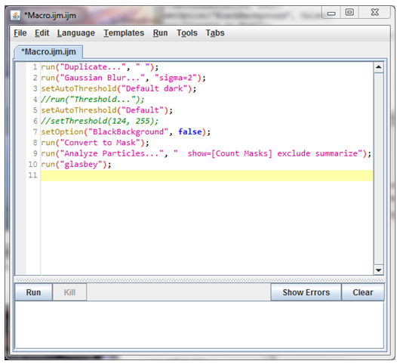
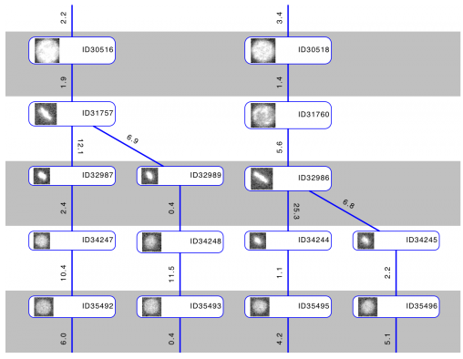
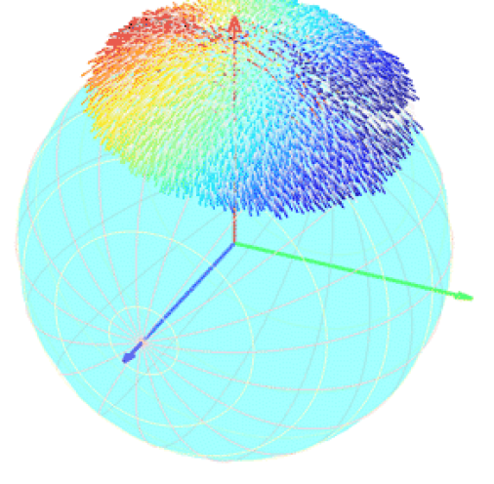
Image Analysis, Intro & basic concepts Bio Image Analysis
Image preparation
Object definition $≈$ Segmentation
Characterization
Interaction, Visualisation, Automation:
Input data
Explore data
Curate segmentation
Script analysis pipeline

Slide 10

Image Analysis, Intro & basic concepts Bio Image Analysis
Image preparation
Object definition $≈$ Segmentation
Characterization
Interaction, Visualisation, Automation

Slide 11
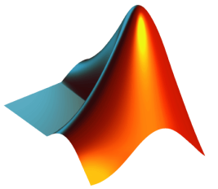
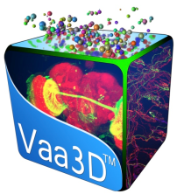




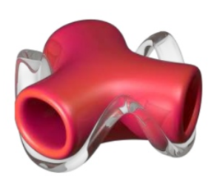


Image Analysis, Intro & basic concepts
Image analysis software
Matlab
Cell profiler
Illastik
Python
Volocity
Knime
Huygens
Imaris
Arivis
Amira
Fiji
Free/Commercial,
Customize versus ease of use
Specific pipelines: slide analysis, HCS, neurons, 3D visualization,
large dataset
Notes:
Word-clouds: ease of use vs. customization
pro vs. cons
typology and location on campus (present each other, who are the people that provide the service?)

Slide 12
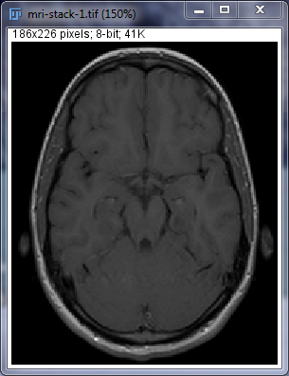
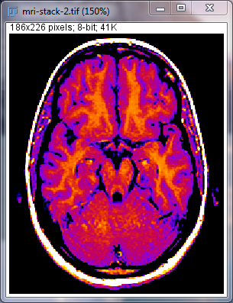
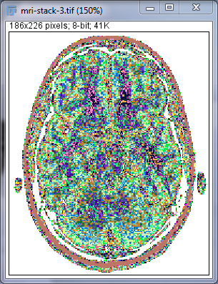
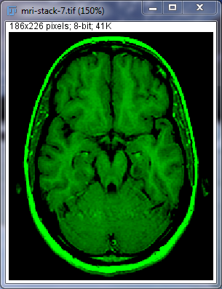
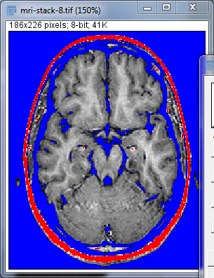
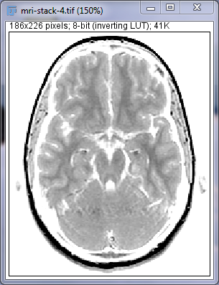
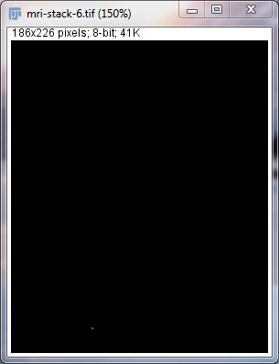
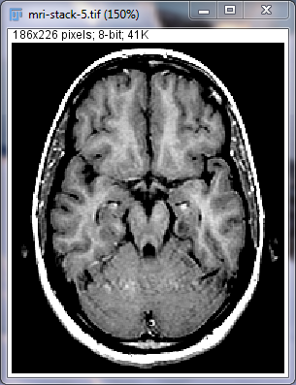
Image Characteristics
and Visualization
Notes:
Blocks a 6/7 slides presenting concepts and tools followed by guided exercises
Blocks start with basic ideas and gradually introduce more complex things
For the exercise we try to have a template that you can follow
The course is an introduction assuming you never have open Fiji (ask a few question to get the room level)
We’ll walk in the room to help
Use Stickers (Green=done!, Red=Help me! ) it will help us adjust timing
For part 5 and 6 At the end the course you’ll exercise/demo you like
1 or 2 depending on time

Slide 13
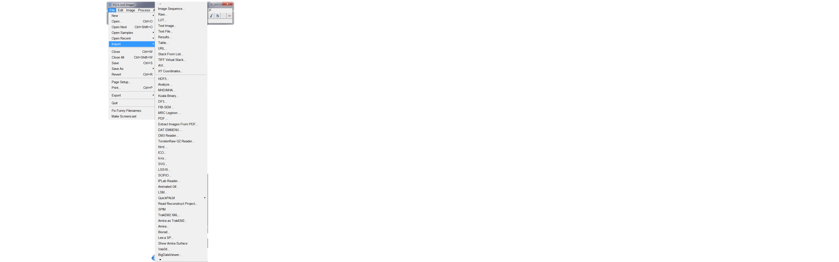
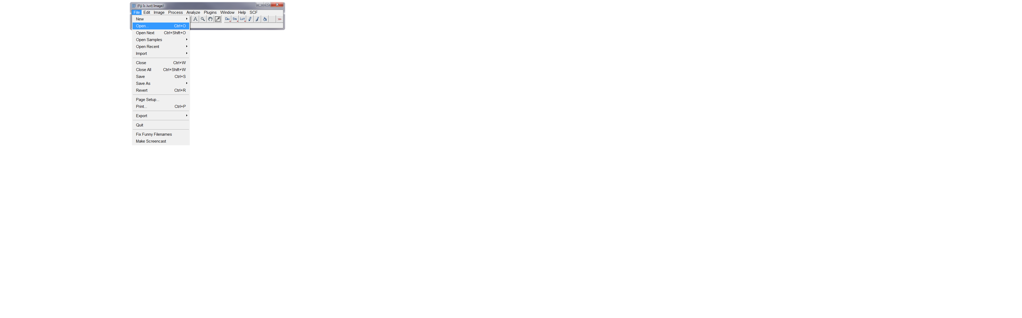
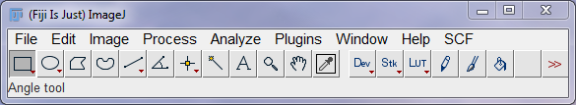


Open images
Image Analysis, Intro & basic concepts

Slide 14


Stitching
Image Analysis, Intro & basic concepts
Image source: Carine Stapel (Vastenhouw lab)

Slide 15



Stitching
Image Analysis, Intro & basic concepts
To do any analysis we need to create a single image
➔ Stitching (Menu Plugins > Stitching > Grid/Collection stitching)
Image source: Carine Stapel (Vastenhouw lab)

Slide 16


The image interface
Image Analysis, Intro & basic concepts
Zoom factor
Image type
Image size in physical units (and in pixels)
Dataset positions

Slide 17



Image Analysis, Intro & basic concepts
Graylevel image
0
255
Notes:
A Gray Level image,
Color image is a superposition of 3 gray level images (Red, Blue, Green)
Multi channel image superimpose multiple images with various colors (this is often the image acquired on microscopes)
In fluorescence microscopy each channel represent different view (the spatial organisation of a protein for instance).
We usually analyze the channel 1 by one 1,
also most of the tools are meant for graylevel image

Slide 18



Image Analysis, Intro & basic concepts
Look Up Tables (LUT)
Image>Lookup Tables
Image>Colors>Display LUTs
Notes:
Also try Image>Colors>Display Luts

Slide 19




Image Analysis, Intro & basic concepts
Bit depth
Pixel value range
Sensitivity of your camera (8, 12, 16 bits)
The more bits the more possible values
?
Notes:
Depends on your camera sensitivity.
Camera can acquire more different intensity than the eye or a screen can actually perceive at the same time.
However using the level control one can see any sub part of the intensity scale.
It is also possible to “compress” the scale to see everything at once (but then the intensity you see are modified)
Regarding the question mark: looking at the image can’t allow to answer (eye, display limitation)
8-bit : 0 to 255 (2⁸-1)
16-bit: 0 to 65535 (2¹⁶-1)
Remark: a particular image might not use all the range

Slide 20








Pixel/Sampling size
Image Analysis, Intro & basic concepts
Pixel size is the distance between 2 measure points
Menu Image > Properties
Pixel size: 0.05 µm
Pixel size: 0.2 µm
Pixel size: 0.8 µm
Pixel size: 3.3 µm
Notes:
Pixel size will have an impact on your area measure

Slide 21




Resolution
Image Analysis, Intro & basic concepts
“The measure of how closely lines can be resolved in an image is called spatial resolution”
Source: https://en.wikipedia.org/wiki/Image_resolution
Notes:
Pixel size and resolution are not the same thing
2 image with same pixel size but different resolution

Slide 22



Histogram
Image Analysis, Intro & basic concepts
Background?
Object?
Number of pixels
Background
Intensity
Number of pixels
Objects
Intensity
Notes:
The frequency/occurence of each intensity value.
A summary of the image.
Convenient for the computer which only sees a list of numbers
And does not perceive the spatial organisation in the image like us

Slide 23


Histogram
Image Analysis, Intro & basic concepts
Notes:
The frequency/occurence of each intensity value.
A summary of the image.
Convenient for the computer which only sees a list of numbers
And does not perceive the spatial organisation in the image like us

Slide 24



Visualization: Brightness/Contrast
Image Analysis, Intro & basic concepts
Define the grey value range to visualize
Also known as “windowing”
Menu Image > Adjust > Brightess/Contrast or SHIFT+CMD+C
0
255

Slide 25



Visualization: Brightness/Contrast
Image Analysis, Intro & basic concepts
Define the grey value range to visualize
Also known as “windowing”
Menu Image > Adjust > Brightess/Contrast or SHIFT+CMD+C
0
85
255

Slide 26





Visualization: Brightness/Contrast
Image Analysis, Intro & basic concepts
Define the grey value range to visualize
Also known as “windowing”
Menu Image > Adjust > Brightess/Contrast or SHIFT+CMD+C
0
48
85
255

Slide 27
Image Analysis, Intro & basic concepts
Gray level image summary
Image
Pixels = measure points
Measure = pixel value
Sampling distance = pixel size
Bit depth indicate the possible pixel value
The histogram gives a summary of value in a given image
Visualisation
Visualization does not modify data
It adapts image to our perception
Look Up Table : each value can be associated to a color
Brightness and contrast allow to change the visualized range
Notes:
The screen can’t display, your eyes can’t perceive all the grey level at once
If you believe only what you see you loose information (similar as when you saturate your acquisition sensor)

Slide 28
Demo
Notes:
Load an image (blobs)
Show the viewer, zoom and pan option
Properties
The command finder
Load (Hella cells)
Show the channel tool and visualization mode
Show pixel value with the mouse
Define pixel size, add a Scale
Show the luts
Show the lut overlay
Show brightness and contrast
Show a 16 bit image (M51 galaxy)
Reproduce mri stack visualisations
Show a color image and a composite image (clown.jpg, hella cells)
To RGB stack, channel control,
Split and merge to go back to a
Can do the stitching hands on if we are in advance (folder to_stitch, snake organisation , x*y = 5*2)

Slide 29

Image Analysis, Intro & basic concepts
Command finder
Press the “L” key
Notes:
Any color can be choosen for the channel
Functionnal meaning of the protein

Slide 30





Image Analysis, Intro & basic concepts
Color Images
Additive color synthesis
Red Green Blue decomposition
Notes:
http://en.wikipedia.org/wiki/RGB_color_model credit for the image
Take that value of your image can be change

Slide 31




Image Analysis, Intro & basic concepts
Color Images decomposition
Image>Type>RGB Stack → red, green and blue image stack.
Image>Color>Channel Tool
Notes:
Check the properties of the image 1 channel to 3 channel

Slide 32


Image Analysis, Intro & basic concepts
Composite Images
Channels can be visualized simultaneously
Image>Color>Channel Tool>Composite
Notes:
Any color can be choosen for the channel
Functionnal meaning of the protein

Slide 33






Image Analysis, Intro & basic concepts
Image summary
Gray level image
d
Pixel Size
Pixel value, Bit depth
Histogram
Visualisation
RGB , Composite Images
LUTs
B&C
Combine gray level images
Notes:
The screen can’t display, your eyes can’t perceive all the grey level at once
If you believe only what you see you loose information (similar as when you saturate your acquisition sensor)

Slide 34

Exercises
Notes:
More time for exercise than previous years
Not all the specific tools you need have been demonstrated
Ask the command finder, each other, google
what tool and how to use it ?
If you are through:
Help you neighbors!
ask us what is next!

Slide 35






Histogram
Image Analysis, Intro & basic concepts
For each image, try interpret its histogram and comment its appearance with your neighbors.
To which of the three images/ROIs does this histogram belong to?
Notes:
1- how to show an histogram

Slide 36

Exercise
Image Analysis, Intro & basic concepts
Prepare image for presentation
Open the image cell_layer2.tif
Split channels
Merge channel 1 and 3
Update channel 1 lut to magenta
Adapt contrast of each channel
Convert type to RGB
Add a scale bar
Save as Tiff
Try to load in a ppt/keynote

Slide 37

Manual Measurements

Slide 38





Image Analysis, Intro & basic concepts Measure workflow
Open an Image
Select a tool and Draw a ROI
Results>File>SaveAs
➔Export data for analysis
Analyze>Set measurements
Analyze>Measure (press M key)
➔ Creates a result table
Notes:
Whenever a tool selection is visible it will influence measure
If no selection is there the measure is made on the whole image

Slide 39

Image Analysis, Intro & basic concepts The Regions of Interest (ROIs)
Region tools:
Rectangle, rounded rectangle
Oval, orientable ellipse, brush tool
Polygon, free form, Wand tool
Line tools : Straight, segmented, free
Point tools : Point, Multi-Point
Interactively Edit ROIs
Double click to see the option
Notes:
Presentation of menu content

Slide 40





The Regions of Interest (ROIs)
Image Analysis, Intro & basic concepts
There are more tools in the toolbar than expected…
Use right-click and double-click to uncover them

Slide 41







The Regions of Interest (ROIs)
Image Analysis, Intro & basic concepts
draw a rectangle
using the rectangle tool
draw a circle
using the circle tool
add objects to the ROI
by holding SHIFT
unite objects to the ROI
by holding SHIFT
Hold SHIFT to unite objects
subtract objects to the
ROI by holding ALT
move the ROI
by clicking inside and move the mouse
delete the ROI
by clicking outside
Recover the last ROI
by using menu Edit > Selection > Restore Selection (SHIFT+CMD+E)

Slide 42

Image Analysis, Intro & basic concepts ROIs & Measures
Analyze>Set Measurements…
Then press “M” or menu
Analyze>Measure
For measurements details : http://rsb.info.nih.gov/ij/docs/menus/analyze.html#set
Notes:
Presentation of menu content

Slide 43








The ROI Manager
Image Analysis, Intro & basic concepts
Menu Analyze > Tools > ROI Manager…
Notes:
store ROIs
Compare, Combine, Edit ROIs
Measure one ROI on multiple images
Measure multiple ROI simultaneously
Prepare ROI before sending them to the overlay

Slide 44



ROI Manager & Measures
Image Analysis, Intro & basic concepts
Visualize, label and measure ROIs
Notes:
Save roi, save measure.
Color roi to make them more informative.
Transition:
Only one roi at a time what does show all does? It sends roi to the overlay

Slide 45


Image Analysis, Intro & basic concepts Image overlay
Menu Image>Overlay>Add selection
Interest:
Visualisation purpose
Image from : http://blogs.qub.ac.uk/ccbg/files/2014/05/2014-05_Analyzing_fluorescence_microscopy_images.pdf

Slide 46

Image Analysis, Intro & basic concepts Summary
Storing regions
Roi manager
Mesure pipeline
Overlay

Slide 47
Demo
Notes:
Open an image (fluorescentCells.tiff)
Count nuclei
Create rois of nuclei
Measure nuclei intensity and area
The exact shape does not matter for the average intensity
Measure another marker intensity inside the nuclei
Interpretation of the intensity measure
Interpretation of the area (pixel size)
Save the image with overlay and reopen it
Save flatenned image and show

Slide 48

Exercise
Image Analysis, Intro & basic concepts
Measure embryo average size
Open Embryos.jpg
Use roi to measure embryos diameter.
Save the result table
Open it in excel and measure the average radius
Add an overlay to the image and save it
Flatten image and save it too
Open image in ppt
Meaning of the intensity?
Notes:
Can do the stitching hands on if some time is left

